Slide 1
MATLAB for image processing Session 3: Advanced data structures

Slide 2
Course structure
Session 1
Introduction to MATLAB
Data types
Conditional statements and loops
Session 3
Advanced data structures
Advanced image reading (Bioformats)
Object-oriented programming
Session 2
Arrays and matrices
Image processing
Session 4
Figures and plotting
Designing a user interface

Slide 3

Under construction!
Comments/requests?
Let me know!
stephen.cross@bristol.ac.uk

Slide 4
Advanced data structures
Notes:
Convert this into 2 spider diagrams if there’s time

Slide 5
Advanced data structures
Arrays and matrices recap
Arrays are a regular grid of numbers in N dimensions
Vectors are 1D arrays, matrices are 2D arrays
☺ Fast access to subsets via indexing
☺ Fast calculations on all values
☹ Can only store numeric values
Alternatives for mixed data types
Cell arrays
Tables
Structure arrays (aka “structs”)

Slide 6
Cell arrays
Similar to arrays, but each element is a “cell”
Regular grid of cells
Can be N-dimensional
Can hold different data types in each cell
A cell can hold any data type, for example
Single numeric values
Text
Numeric arrays and matrices
Even another cell array!

Slide 7
Cell arrays
Similar to arrays, but each element is a “cell”
Regular grid of cells
Can be N-dimensional
Can hold different data types in each cell
A cell can hold any data type, for example
Single numeric values
Text
Numeric arrays and matrices
Even another cell array!

Slide 8
Cell arrays
Similar to arrays, but each element is a “cell”
Regular grid of cells
Can be N-dimensional
Can hold different data types in each cell
A cell can hold any data type, for example
Single numeric values
Text
Numeric arrays and matrices
Even another cell array!
0.9
-128

Slide 9
Cell arrays
Similar to arrays, but each element is a “cell”
Regular grid of cells
Can be N-dimensional
Can hold different data types in each cell
A cell can hold any data type, for example
Single numeric values
Text
Numeric arrays and matrices
Even another cell array!
‘some text’
0.9
-128
‘more stuff’

Slide 10
Cell arrays
Similar to arrays, but each element is a “cell”
Regular grid of cells
Can be N-dimensional
Can hold different data types in each cell
A cell can hold any data type, for example
Single numeric values
Text
Numeric arrays and matrices
Even another cell array!
‘some text’
0.9
1.2 | 3.7
0.7 | -5.5
-128
‘more stuff’

Slide 11
Cell arrays
Similar to arrays, but each element is a “cell”
Regular grid of cells
Can be N-dimensional
Can hold different data types in each cell
A cell can hold any data type, for example
Single numeric values
Text
Numeric arrays and matrices
Even another cell array!
‘some text’
0.9
1.2 | 3.7
0.7 | -5.5
-128
‘more stuff’
‘a’
42

Slide 12
Cell arrays
Create cell arrays using braces
Same method as creating arrays (rows, then columns)
To create our example cell array
Creating the 2x2 array
num_arr = [1.2, 3.7; 0.7, -5.5]
Creating the mini cell array
mini_cell = {‘a’,42}
Creating the main cell array
cell_array = { 0.9 , ‘some_text’ ; num_arr , -128 ; ‘more stuff’ , mini_cell }
‘some text’
0.9
1.2 | 3.7
0.7 | -5.5
-128
‘more stuff’
‘a’
42

Slide 13
Tables
Sdf
Tables
[When were they introduced?]
[What are the benefits?]
[Loading data directly from file into a table]

Slide 14
Structure arrays
Values stored as “fields”
Accessed using that field’s reference via dot notation
Can hold different data types in each field
Can have fields within fields
Example struct creation
im_meas.filename= ‘cell_image_001.tif’
im_meas.xy_calib= 0.0127
im_meas.centroids.obj_1 = [103, 24]
im_meas.centroids.obj_2 = [87, 216]
im_meas.centroids.obj_3 = [4, 68]

Slide 15
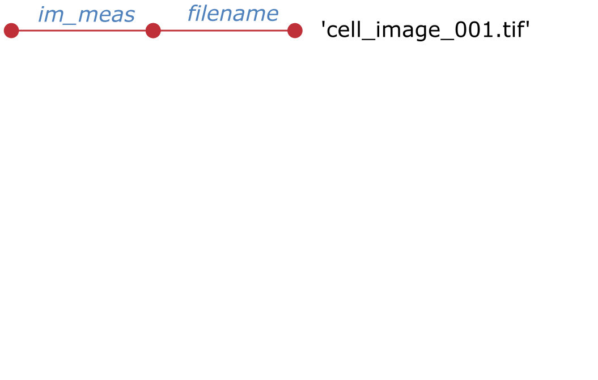
Structure arrays
Values stored as “fields”
Accessed using that field’s reference via dot notation
Can hold different data types in each field
Can have fields within fields
Example struct creation
im_meas.filename= ‘cell_image_001.tif’
im_meas.xy_calib= 0.0127
im_meas.centroids.obj_1 = [103, 24]
im_meas.centroids.obj_2 = [87, 216]
im_meas.centroids.obj_3 = [4, 68]

Slide 16
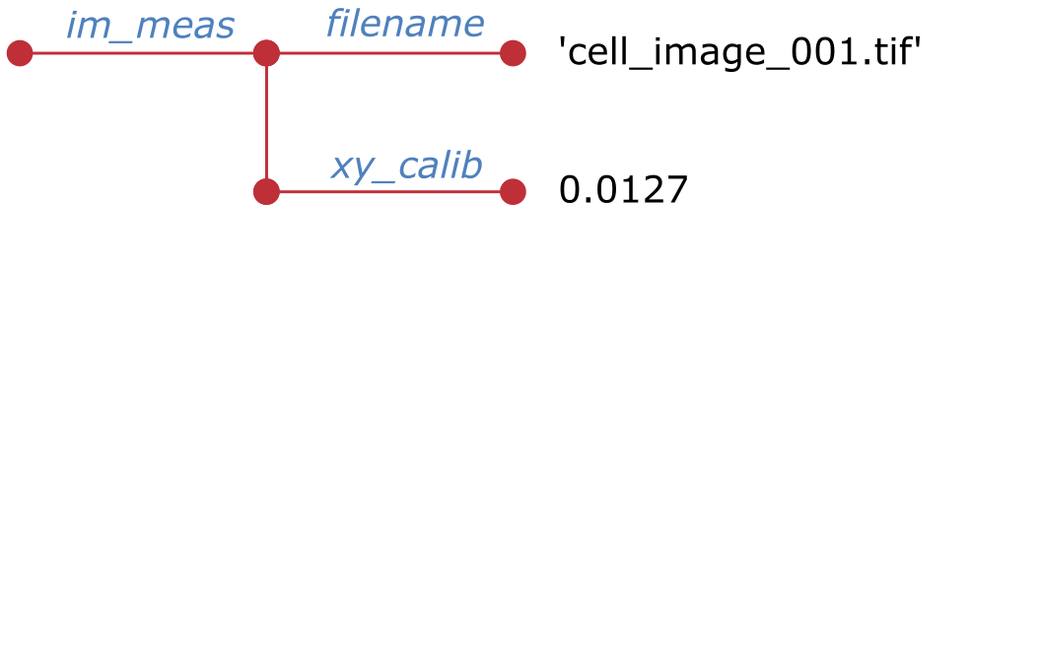
Structure arrays
Values stored as “fields”
Accessed using that field’s reference via dot notation
Can hold different data types in each field
Can have fields within fields
Example struct creation
im_meas.filename= ‘cell_image_001.tif’
im_meas.xy_calib= 0.0127
im_meas.centroids.obj_1 = [103, 24]
im_meas.centroids.obj_2 = [87, 216]
im_meas.centroids.obj_3 = [4, 68]

Slide 17
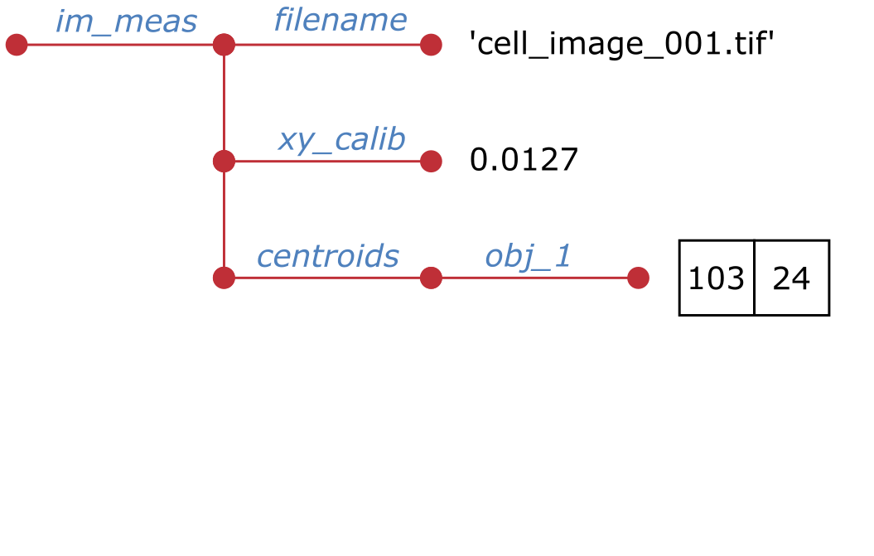
Structure arrays
Values stored as “fields”
Accessed using that field’s reference via dot notation
Can hold different data types in each field
Can have fields within fields
Example struct creation
im_meas.filename= ‘cell_image_001.tif’
im_meas.xy_calib= 0.0127
im_meas.centroids.obj_1 = [103, 24]
im_meas.centroids.obj_2 = [87, 216]
im_meas.centroids.obj_3 = [4, 68]

Slide 18
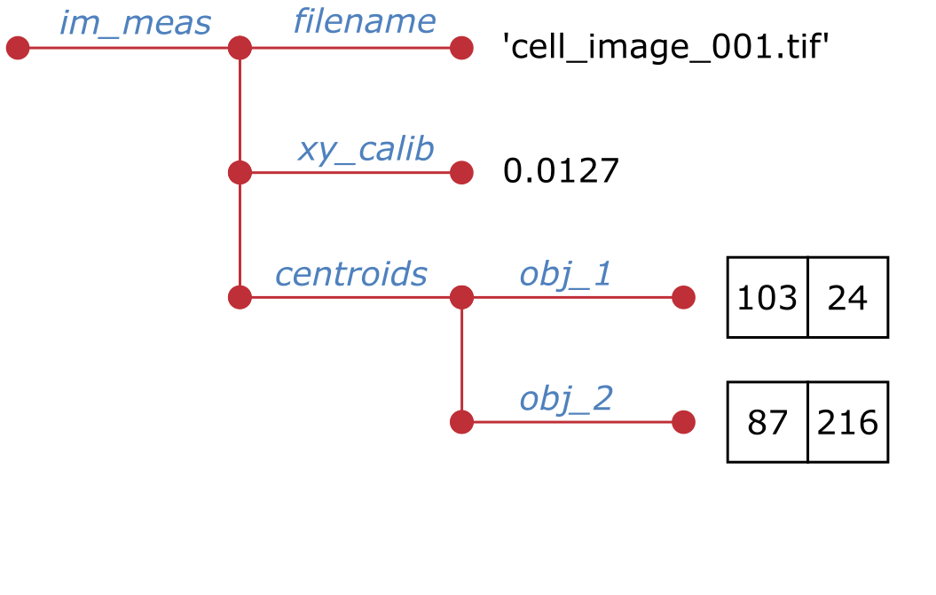
Structure arrays
Values stored as “fields”
Accessed using that field’s reference via dot notation
Can hold different data types in each field
Can have fields within fields
Example struct creation
im_meas.filename= ‘cell_image_001.tif’
im_meas.xy_calib= 0.0127
im_meas.centroids.obj_1 = [103, 24]
im_meas.centroids.obj_2 = [87, 216]
im_meas.centroids.obj_3 = [4, 68]

Slide 19
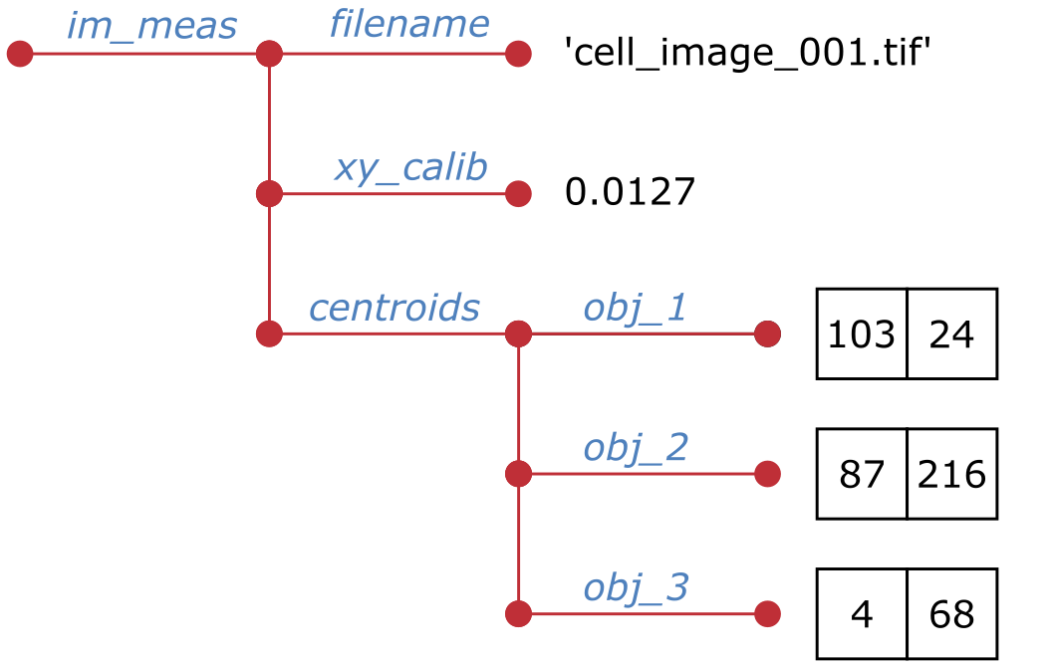
Structure arrays
Values stored as “fields”
Accessed using that field’s reference via dot notation
Can hold different data types in each field
Can have fields within fields
Example struct creation
im_meas.filename= ‘cell_image_001.tif’
im_meas.xy_calib= 0.0127
im_meas.centroids.obj_1 = [103, 24]
im_meas.centroids.obj_2 = [87, 216]
im_meas.centroids.obj_3 = [4, 68]

Slide 20
Structure arrays
Accessing data in a struct
Similar to assignment, using dot notation
Accessing our example struct
filename = im_meas.filename
xy_calib = im_meas.xy_calib
obj1_cent = im_meas.centroids.obj_1
obj2_cent_x = im_meas.centroids.obj_3(1)
obj3_cent_y = im_meas.centroids.obj_3(2)

Slide 21
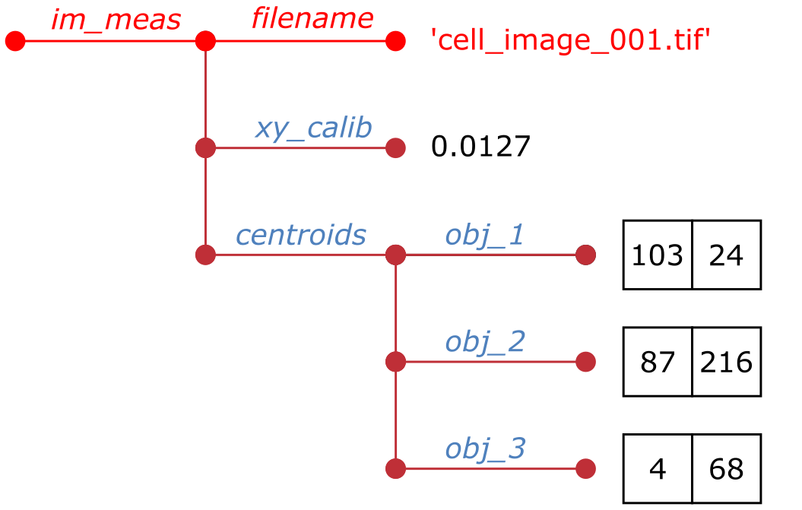
Structure arrays
Accessing data in a struct
Similar to assignment, using dot notation
Accessing our example struct
filename = im_meas.filename
xy_calib = im_meas.xy_calib
obj1_cent = im_meas.centroids.obj_1
obj2_cent_x = im_meas.centroids.obj_3(1)
obj3_cent_y = im_meas.centroids.obj_3(2)

Slide 22
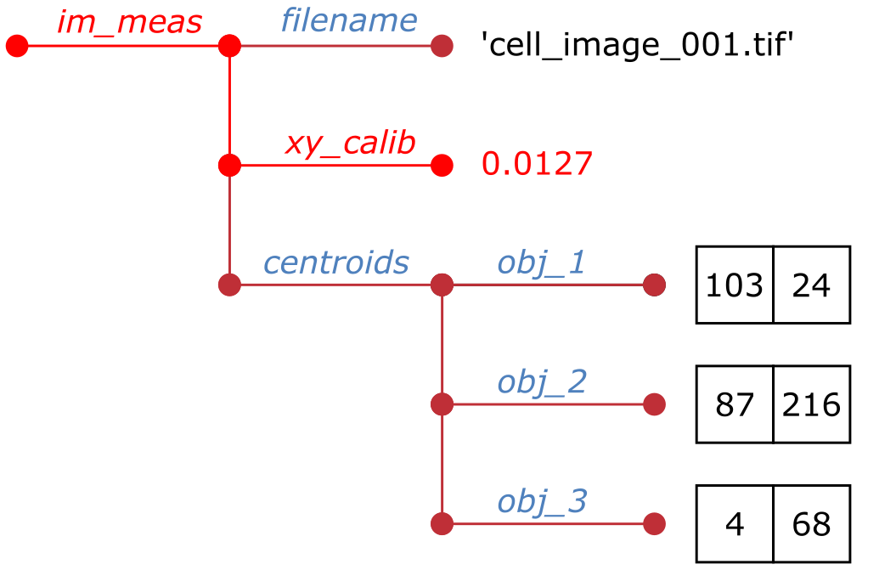
Structure arrays
Accessing data in a struct
Similar to assignment, using dot notation
Accessing our example struct
filename = im_meas.filename
xy_calib = im_meas.xy_calib
obj1_cent = im_meas.centroids.obj_1
obj2_cent_x = im_meas.centroids.obj_3(1)
obj3_cent_y = im_meas.centroids.obj_3(2)

Slide 23
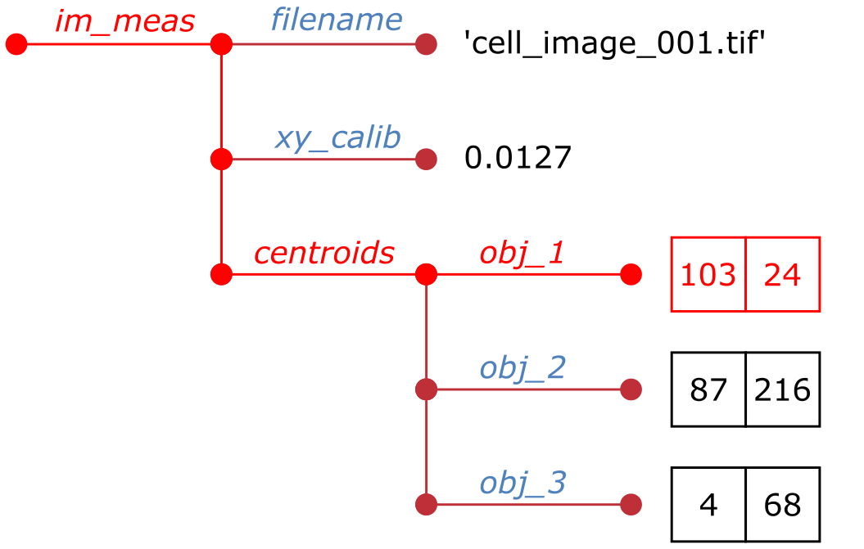
Structure arrays
Accessing data in a struct
Similar to assignment, using dot notation
Accessing our example struct
filename = im_meas.filename
xy_calib = im_meas.xy_calib
obj1_cent = im_meas.centroids.obj_1
obj2_cent_x = im_meas.centroids.obj_3(1)
obj3_cent_y = im_meas.centroids.obj_3(2)

Slide 24
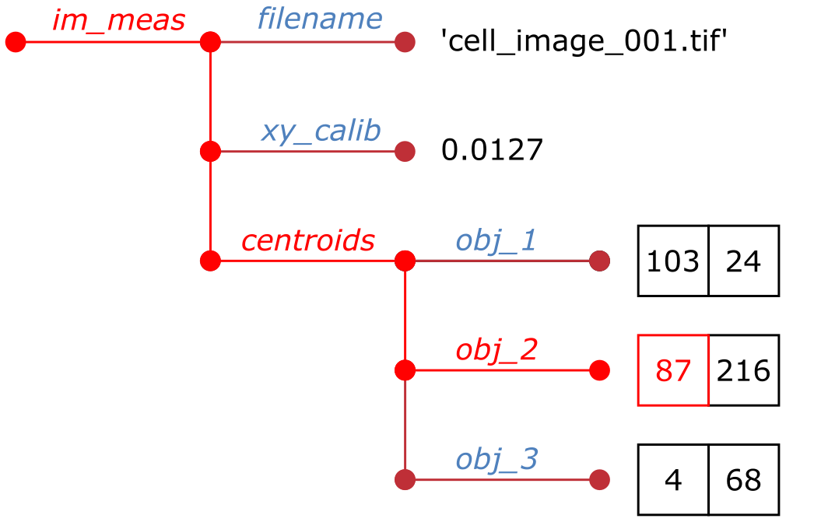
Structure arrays
Accessing data in a struct
Similar to assignment, using dot notation
Accessing our example struct
filename = im_meas.filename
xy_calib = im_meas.xy_calib
obj1_cent = im_meas.centroids.obj_1
obj2_cent_x = im_meas.centroids.obj_3(1)
obj3_cent_y = im_meas.centroids.obj_3(2)

Slide 25
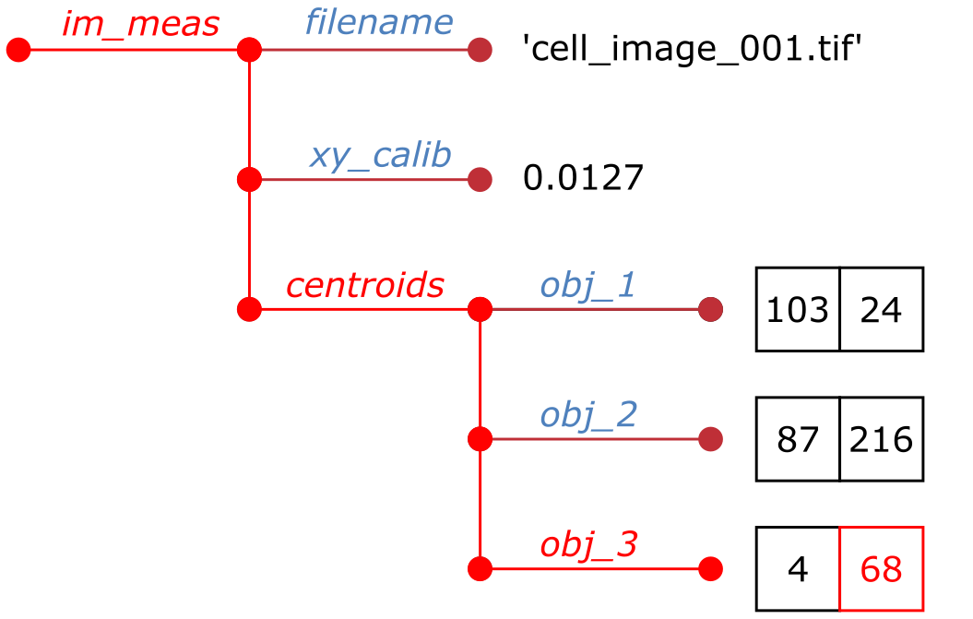
Structure arrays
Accessing data in a struct
Similar to assignment, using dot notation
Accessing our example struct
filename = im_meas.filename
xy_calib = im_meas.xy_calib
obj1_cent = im_meas.centroids.obj_1
obj2_cent_x = im_meas.centroids.obj_3(1)
obj3_cent_y = im_meas.centroids.obj_3(2)

Slide 26
Object oriented programming
Notes:
Convert this into 2 spider diagrams if there’s time

Slide 27
Intro to OOP
What are objects, classes and methods
Why would we use this?
Example of OOP
Class could refer to physical object, but could also be something that does a job
Maybe use nuclear detection as an example
Using objects and methods
Find function which outputs objects (maybe something imaging related – maybe Bioformats…)
Creating objects

Slide 28
Advanced image reading (Bioformats)
Notes:
Convert this into 2 spider diagrams if there’s time

Slide 29
[Maybe do this after OOP, as BF has OOP format]
Quick intro to Bioformats
Example formats it can work with
Mention metadata (what sort of values it stores)
Method of getting Bioformats to work
Where to download from
Provide link
Installation
Download, unzip, add to path
Running a basic LIF import
Dealing with multiple series
Dealing with metadata

Slide 30
Questions?!
Notes:
Convert this into 2 spider diagrams if there’s time

Slide 31
Under construction!
Comments/requests?
Let me know!
stephen.cross@bristol.ac.uk

